Slide 1
IMCC QA Course Ajinkya Nimbarte Sharad Bhagwat

Slide 2
Introduction
About Veritas
Veritas Products
Veritas Solutions
What is Quality Assurance
Course Contents
Automation Setup

Slide 3

About Veritas

Slide 4
About Veritas
Veritas Technologies LLC. is an American international data management company headquartered in Santa Clara, California.
The company founded in 1983
It specializes in storage management software including the first commercial journaling file system, VxFS, VxVM, VCS, the personal/small office backup software Backup Exec and the enterprise backup software, NetBackup.
Veritas is uniquely equipped to help organizations of all sizes conquer the complexity of managing and protecting their business-critical data. Through our integrated product portfolio, we provide a unified data management experience that delivers unmatched performance and versatility—edge to core to cloud.

Slide 5
Why Veritas?
https://www.veritas.com/why-veritas
we are creating our footprint in containerizing our product lines and making the solutions available or Cloud.

Slide 6
Veritas Products
DATA PROTECTION
NetBackup
The #1 enterprise backup and recovery solution
NetBackup Recovery Vault
Cloud-based data storage fully integrated with NetBackup
NetBackup SaaS Protection
Secure your entire suite, not a percentage of it
Backup Exec
Our simplest, more cost-effective data recovery solution
NetBackup Appliance Solutions
Quickly deploy and easily manage ransomware resilient NetBackup data protection

Slide 7
Veritas Products
AVAILABILITY
InfoScale
Protect your data with SLA-driven resilience platforms
INSIGHTS
NetBackup IT Analytics
Predictive analytics for unified insights.
Data Insight
Data classification, file analysis, and unstructured data visibility.

Slide 8
Veritas Products
COMPLIANCE
Merge1
Partners in data archival excellence
Enterprise Vault
Automated data capture and information archiving
Enterprise Vault. Cloud
Cloud based archiving for data governance
eDiscovery Platform
Digital forensics, investigations, and document review

Slide 9
What is Quality Assurance
Quality Assurance refers to process management activities which are aimed at reducing defects and errors for the end customer. QA involves looking at how the processes are performed and making sure that the quality requirements are being fulfilled. It is a proactive, process-based approach which aims to manage the quality of a product before and during the production process.
A Quality Assurance Specialist is a team member who checks whether the app works correctly in such a way to meet users/business requirements.

Slide 10
The Importance of Quality Assurance in Software Development
QA HELPS TO REDUCE COST AND SAVES TIME
Having QA systems in place during your production life-cycle allows you to anticipate and prevent issues such as bugs, defects, and errors from ever occurring. By identifying problems in the initial stages, you can put fixes in place early, helping you save time and money.
QA HELPS TO MAINTAIN THE QUALITY OF YOUR PRODUCT
Having QA processes in place allows you to maintain the reliability and stability of your product. Fewer problems means better quality
QA ENSURES THAT YOUR PRODUCT IS SECURE
Security is always a huge priority when it comes to software, so it makes sense that a company’s QA processes should have a strong focus in this area
QA ENSURES THAT YOUR PRODUCT IS SECURE
Security is always a huge priority when it comes to software, so it makes sense that a company’s QA processes should have a strong focus in this area

Slide 11
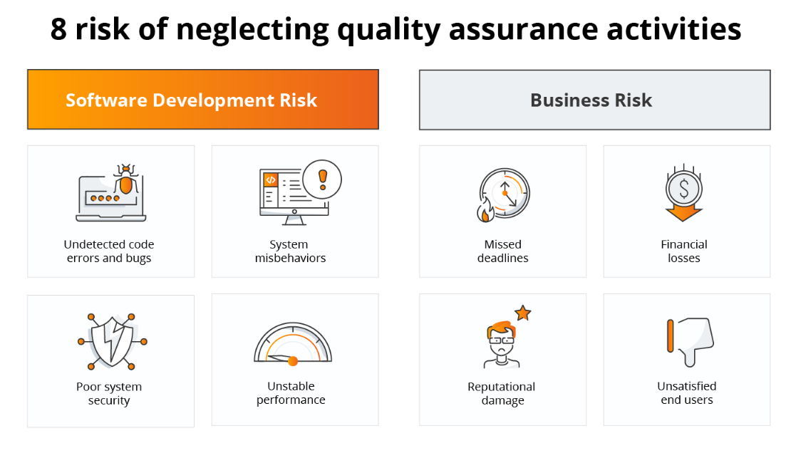

Slide 12
QA Specializations
Manual (Functional and GUI)
They run manual tests to identify bugs, issues, and defects in the software
Automation Testing
They design automated tests to check the functionality of applications
Narrowly Targeted
Security testing
Performance
Usability

Slide 13
Course Contents
Product (Veritas Alta View)
Why, what & how to Test
Test Management Life-Cycle
Defect Life Cycle
QA Roles
Need for Automation / Importance
Tools for Automation
Introduction to the Web Site to be used for automation.
Automation workshops – Robot,Selenium

Slide 14
Automation Setup Pre-requisite:
Windows machine (4 GB Ram) with internet connectivity
Python 3.x., should be added in environment variables Link to Download: https://www.python.org/downloads/release/python-3105/
Pip get automatically installed with python; Else we need to download get-pip.py from
https://bootstrap.pypa.io/get-pip.py and run Python get-pip.py
PyCharm editor

Slide 15
Automation Setup Pre-requisite:
Requirements.txt
paramiko==2.11.0
requests==2.28.1
robotframework==5.0.1
robotframework-jsonlibrary==0.5
robotframework-seleniumlibrary==6.0
To install above packages, run command
pip install –r requirements.txt

Slide 16
Automation Setup Pre-requisite:
Robot
Install robot framework: pip install robot framework.
PyCharm editor
Robot selenium Lib: pip install robotframework-seleniumlibrary
Firefox or Chrome browser
Chrome Browser Driver: https://chromedriver.chromium.org/downloads

Slide 17
Thank You

